Slide 1
et simulation project
9th Sep 2020

Slide 2
Section 1. Small system
1. Multiple emitters in one system
2. Multiple systems possessing their own emitters
All the system have the same absorption
Systems have different absorption
3. In which case SFA model does not work
Section 2. Large system
1. Solution
2. Molecules (two dipoles): β – et – r0
3. Molecules (Three dipoles): β – et - r0
Others
1. How many dipoles can be distinguished from 2D portrait
2. Hints from fitting results

Slide 3
Section 1. Small systems

Slide 4
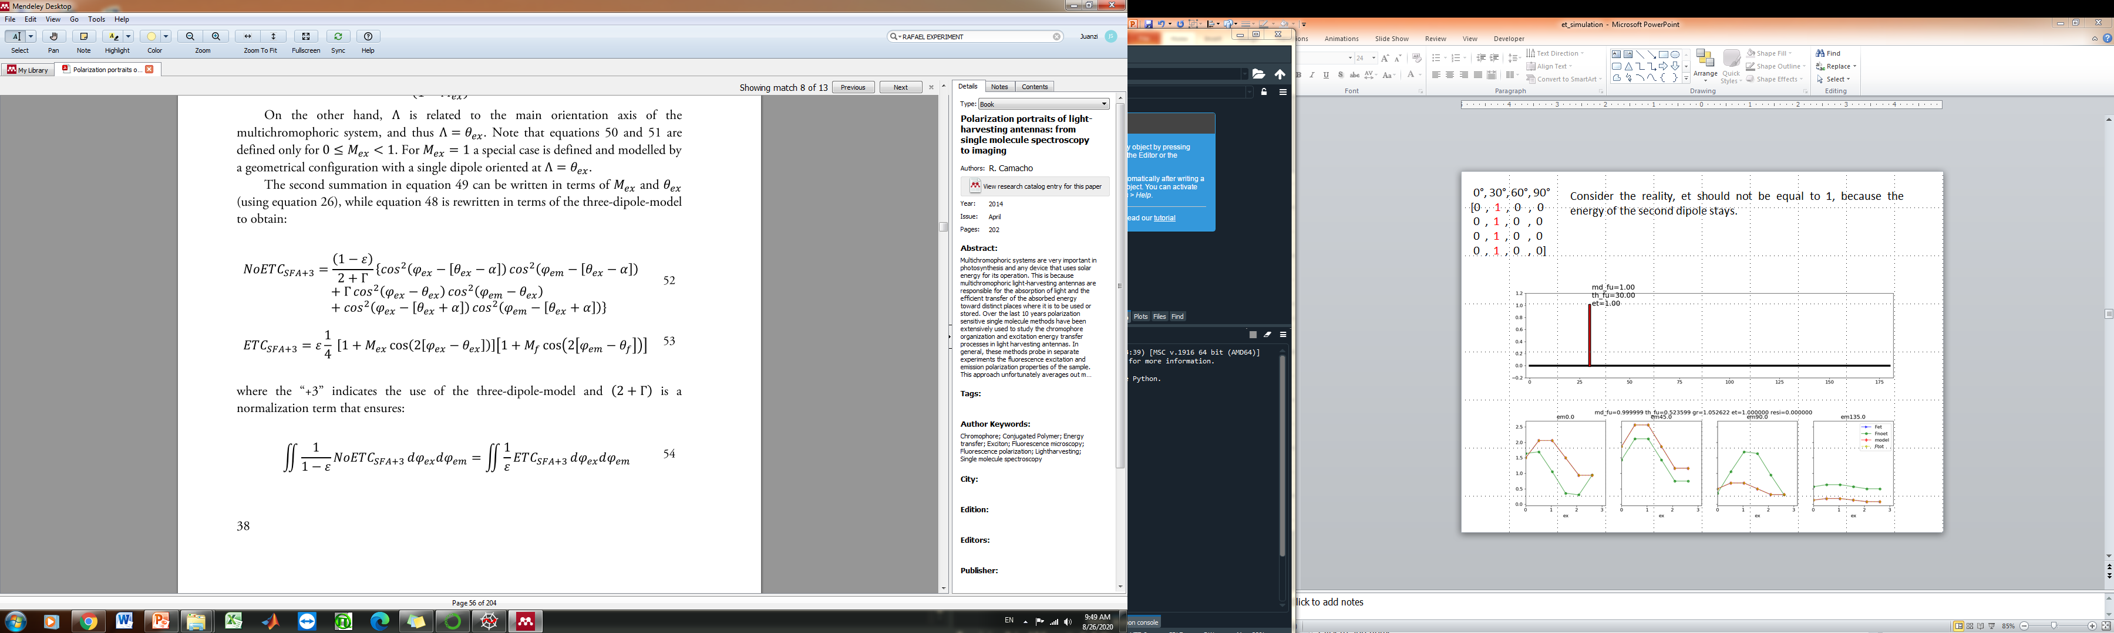
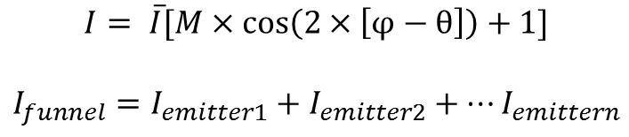
Multiple emitters in one system
SFA model works well for multiple emitters exist in one system.
The funnel is the linear superposition of all individual emitters.
emitter1
emitter1
emitter2
emitter2
emitter3
$$I= \overline{I}[M×\cos\left(2×\left[φ−θ\right]\right)+1]$$
$$I_{funnel}=I_{emitter1}+I_{emitter2}+…I_{emittern}$$
28th August, 2020

Slide 5
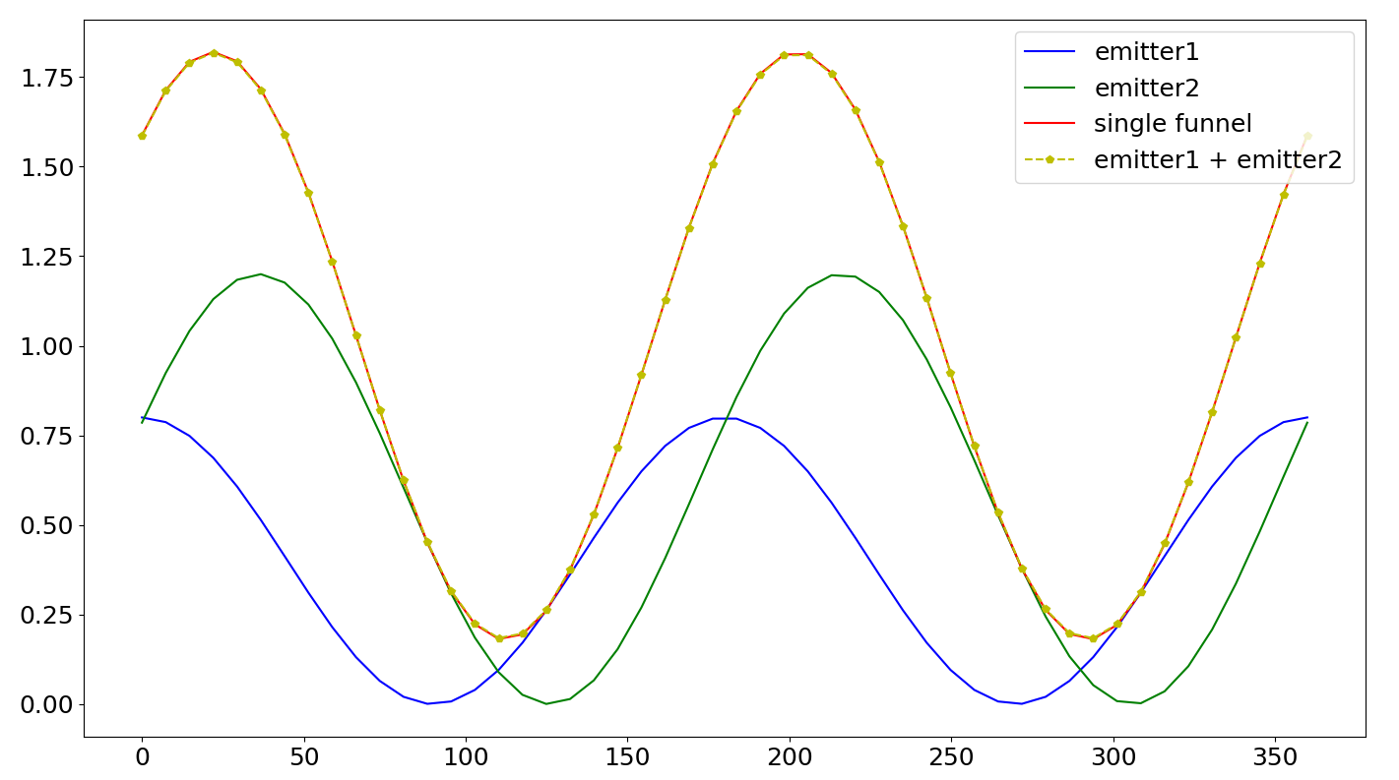
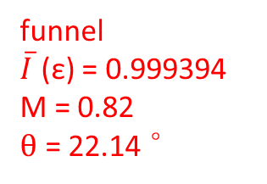
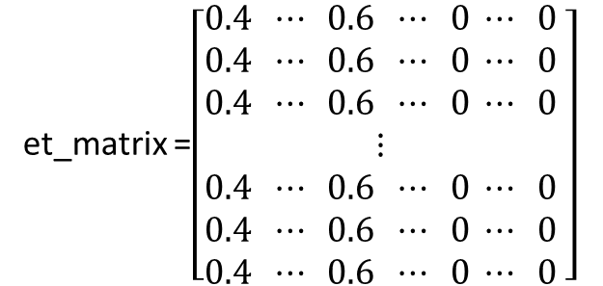
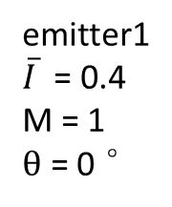
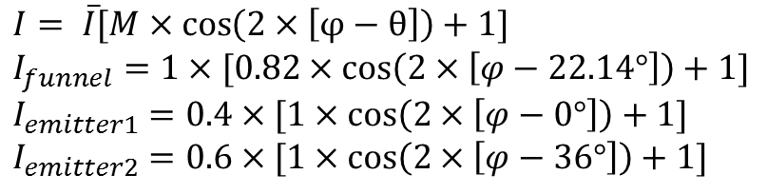
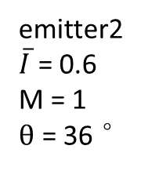
Two emitters in one system
0°
36°
et_matrix =$\left[\begin{aligned}0.4 ⋯ 0.6 ⋯ 0 ⋯ 0 \\ 0.4 ⋯ 0.6 ⋯ 0 ⋯ 0 \\ 0.4 ⋯ 0.6 ⋯ 0 ⋯ 0 \\ ⋮ \\ 0.4 ⋯ 0.6 ⋯ 0 ⋯ 0 \\ 0.4 ⋯ 0.6 ⋯ 0 ⋯ 0 \\ 0.4 ⋯ 0.6 ⋯ 0 ⋯ 0\end{aligned} \right]$
1000
$$I= \overline{I}[M×\cos\left(2×\left[φ−θ\right]\right)+1]$$
$$I_{funnel}=1×[0.82×\cos\left(2×\left[φ−22.14°\right]\right)+1]$$
$$I_{emitter1}=0.4×[1×\cos\left(2×\left[φ−0°\right]\right)+1]$$
$$I_{emitter2}=0.6×[1×\cos\left(2×\left[φ−36°\right]\right)+1]$$
1000
funnel
$\overline{I}$ (ε) = 0.999394
M = 0.82
$θ$ = 22.14 °
The funnel is the linear superposition of all individual emitters.
0°
36°
180 °
emitter1
$\overline{I}$ = 0.4
M = 1
$θ$ = 0 °
emitter2
$\overline{I}$ = 0.6
M = 1
$θ$ = 36 °

Slide 6
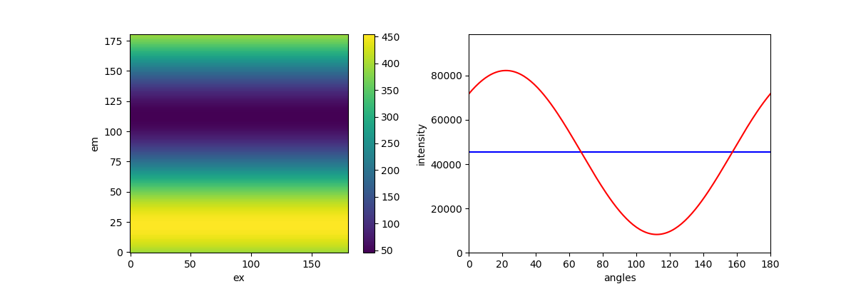
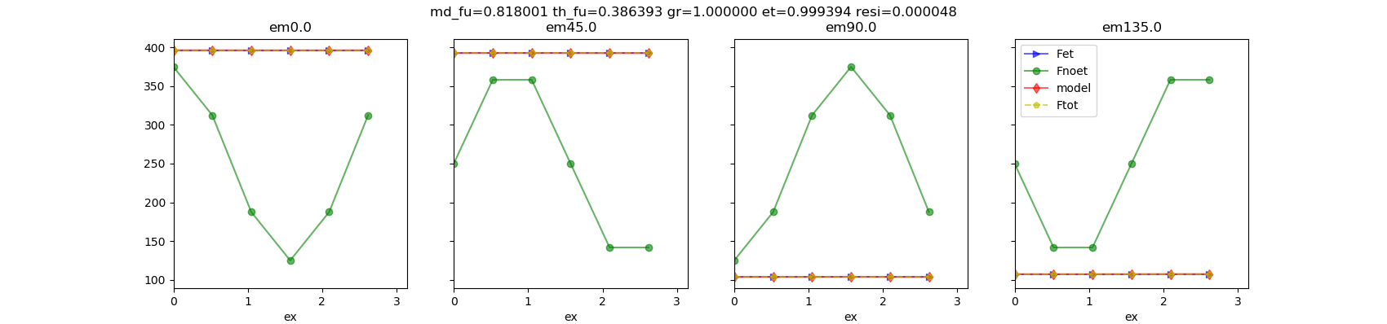
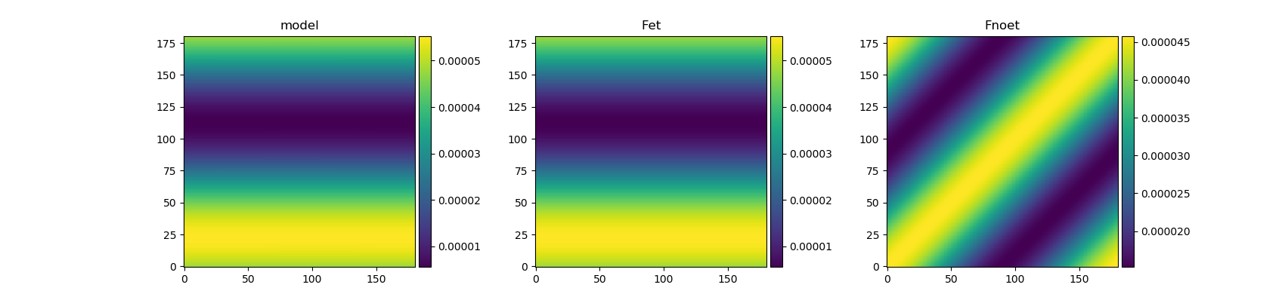
Two emitters
ET
36°, 60%
0°, 40%
1000 dipoles

Slide 7
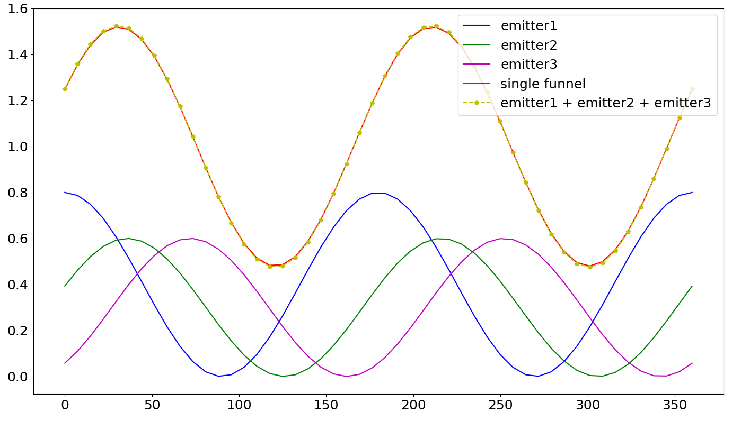
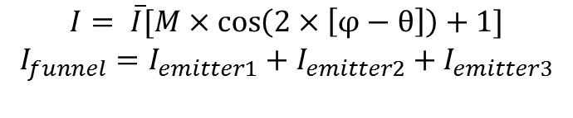
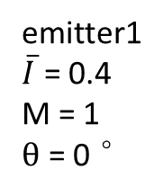
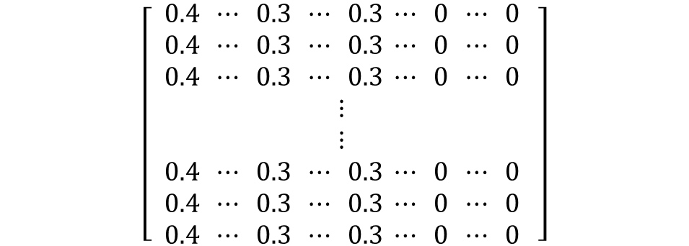
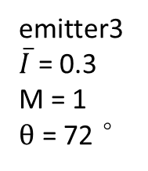
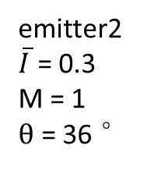
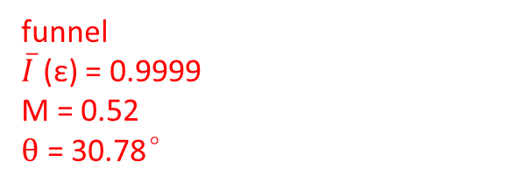
Three emitters in one system
0°
36°
72°
$$\left[\begin{aligned} 0.4 ⋯ 0.3 ⋯ 0.3 ⋯ 0 ⋯ 0 \\ 0.4 ⋯ 0.3 ⋯ 0.3 ⋯ 0 ⋯ 0 \\ 0.4 ⋯ 0.3 ⋯ 0.3 ⋯ 0 ⋯ 0 \\ ⋮ \\ ⋮ \\ 0.4 ⋯ 0.3 ⋯ 0.3 ⋯ 0 ⋯ 0 \\ 0.4 ⋯ 0.3 ⋯ 0.3 ⋯ 0 ⋯ 0 \\ 0.4 ⋯ 0.3 ⋯ 0.3 ⋯ 0 ⋯ 0\end{aligned} \right]$$
1000
$$I= \overline{I}[M×\cos\left(2×\left[φ−θ\right]\right)+1]$$
$$I_{funnel}=I_{emitter1}+I_{emitter2}+I_{emitter3}$$
1000
funnel
$\overline{I}$ (ε) = 0.9999
M = 0.52
$θ$ = 30.78°
0°
36°
72°
180 °
emitter1
$\overline{I}$ = 0.4
M = 1
$θ$ = 0 °
emitter2
$\overline{I}$ = 0.3
M = 1
$θ$ = 36 °
emitter3
$\overline{I}$ = 0.3
M = 1
$θ$ = 72 °

Slide 8
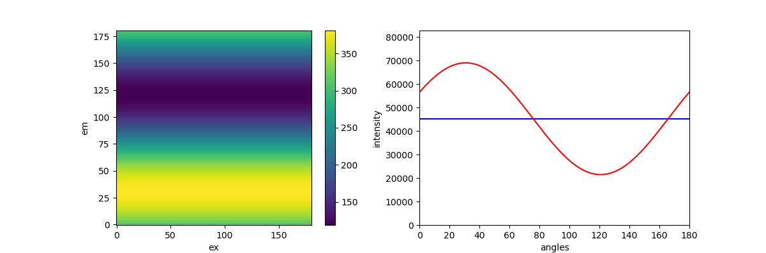
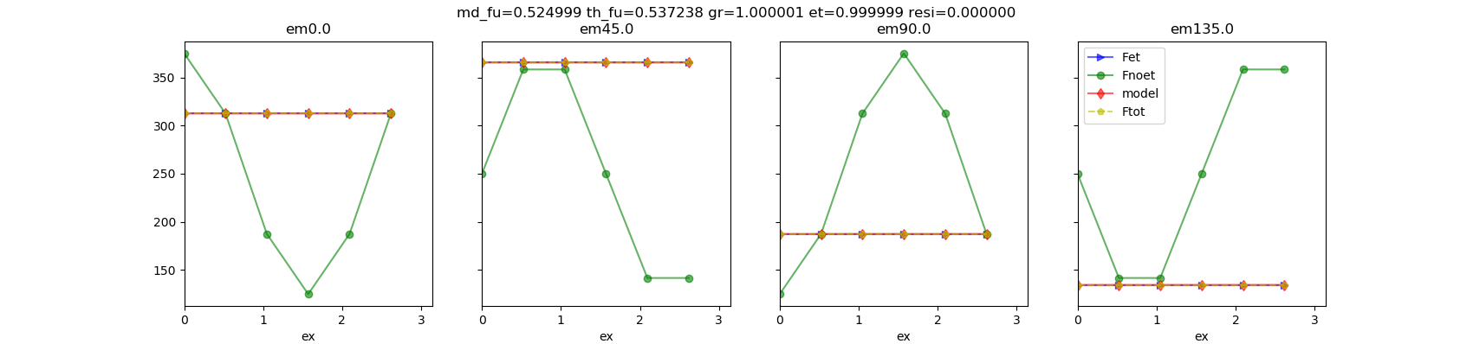
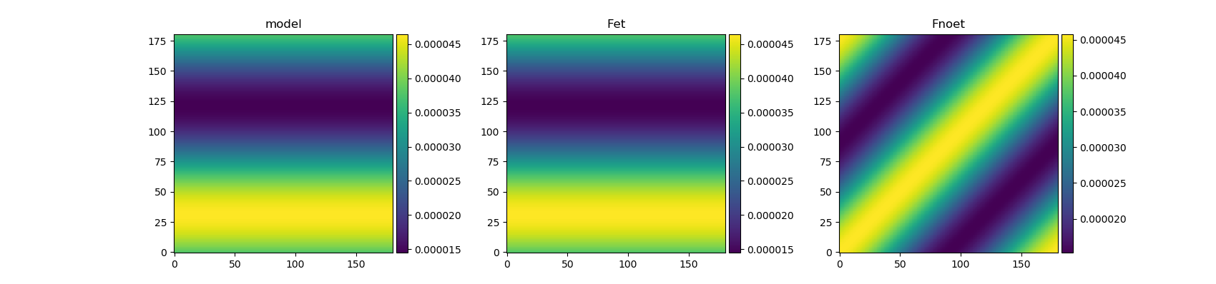
Three emitters
72°, 30%
ET
36°, 30%
0°, 40%
1000 dipoles

Slide 9
Multiple systems (ms) possessing their own emitters
All the systems have the same absorption
SFA works well when all the systems have the same absorption.
The funnel is the linear superposition of individual emitters in different systems.
If the ratio between two systems is the same as the ratio between two emitters in one system, then the 2D portrait and SFA fitting results are the same.
28th August, 2020

Slide 10

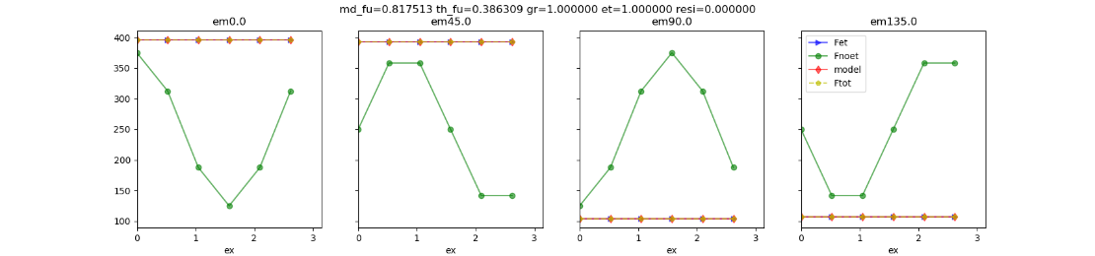
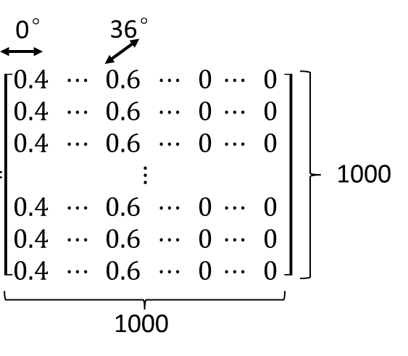
0°
36°
P1
P2
et_1 = 1
et_2 = 1
0.4
0.6
ms = 0.4*P1 + 0.6*P2
emitter1
emitter2

Slide 11
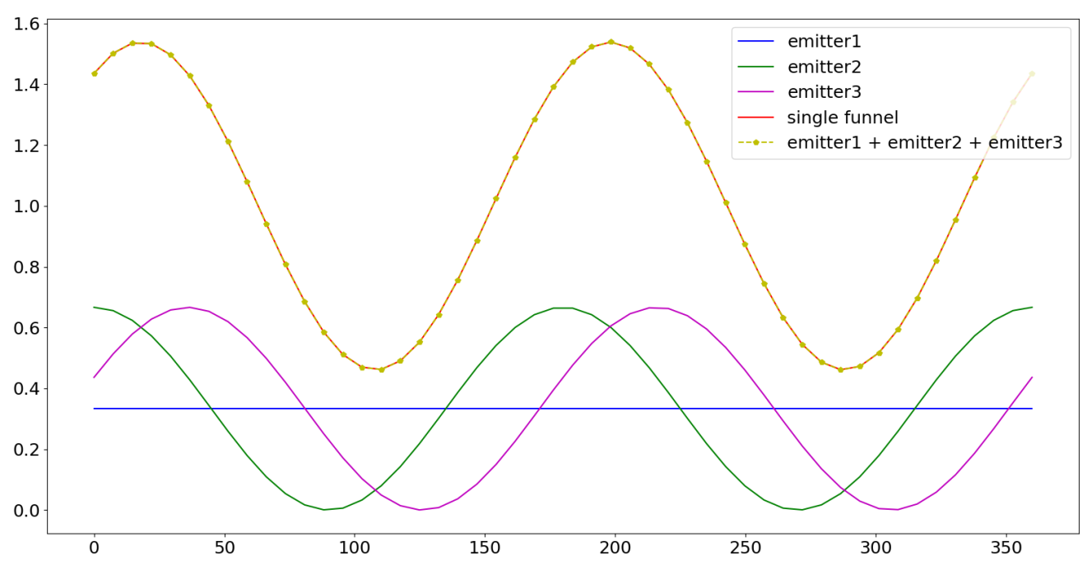
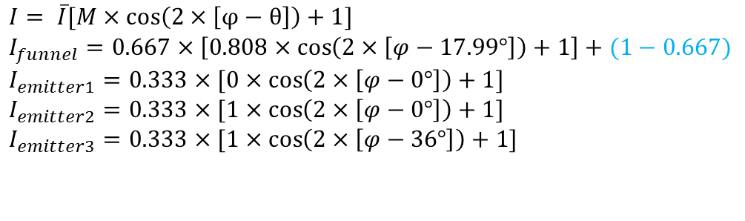
Multiple systems
ms = 0.333*P1 + 0.333*P2 + 0.333*P3
0°
36°
P1
P2
P3
et_1 = 0
et_2 = 1
et_3 = 1
$$I= \overline{I}[M×\cos\left(2×\left[φ−θ\right]\right)+1]$$
$$I_{funnel}=0.667×\left[0.808×\cos\left(2×\left[φ−17.99°\right]\right)+1\right]+(1−0.667)$$
$$I_{emitter1}=0.333×[0×\cos\left(2×\left[φ−0°\right]\right)+1]$$
$$I_{emitter2}=0.333×[1×\cos\left(2×\left[φ−0°\right]\right)+1]$$
$$I_{emitter3}=0.333×[1×\cos\left(2×\left[φ−36°\right]\right)+1]$$

Slide 12
Systems have different absorption and emission
SFA does not work well when both excitation and emission polarization are different.
The model only work if one of the term (in the following equation) is the same for all the systems.
term1
term2

Slide 13
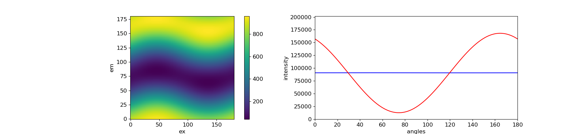
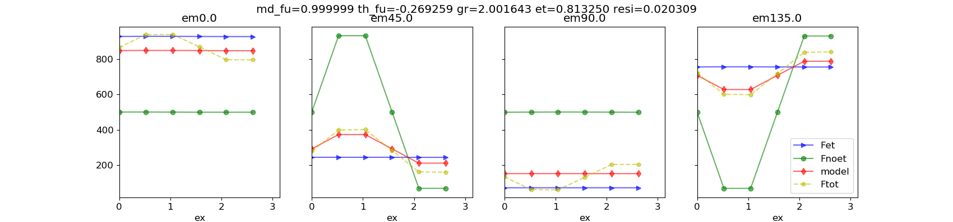
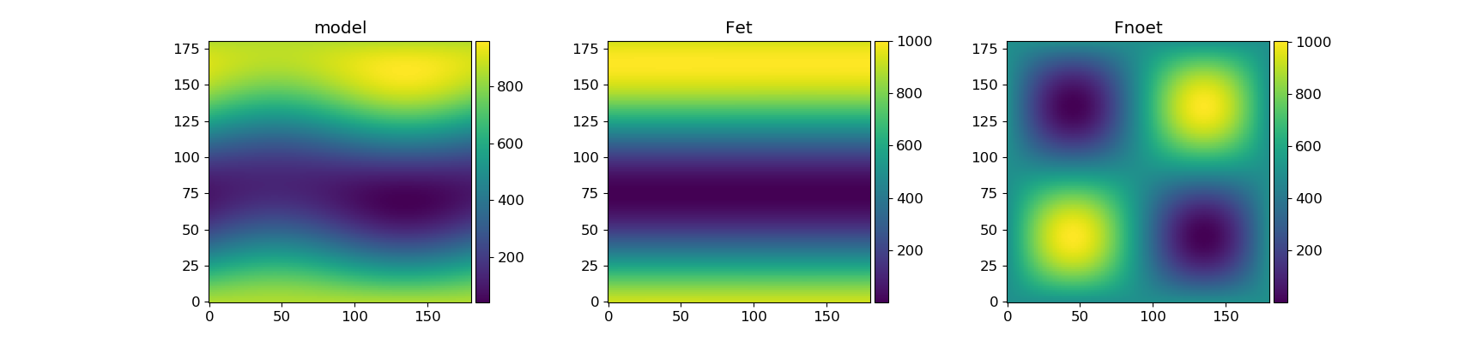
0°
150°
P1
P2
et_1 = 1
et_2 = 1
ms = P1 + P2

Slide 14
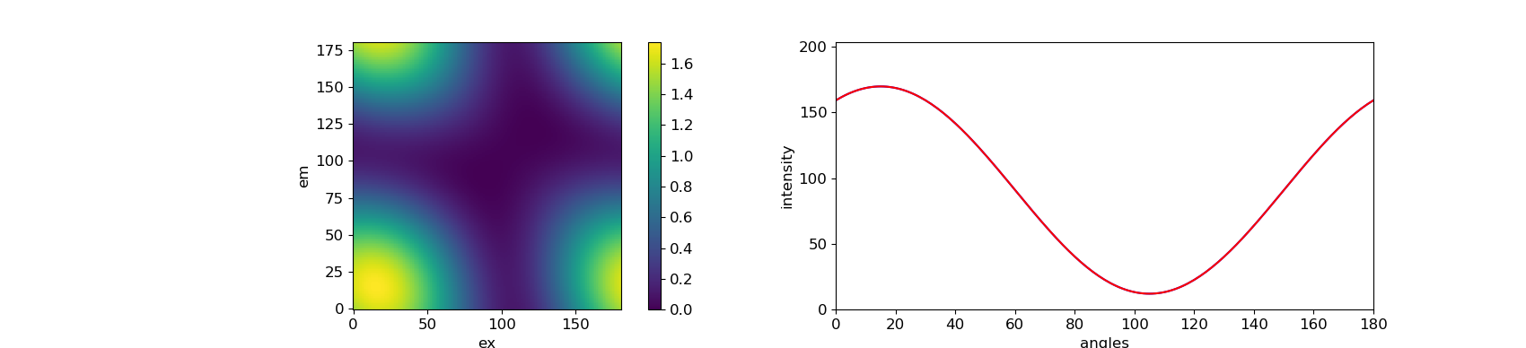
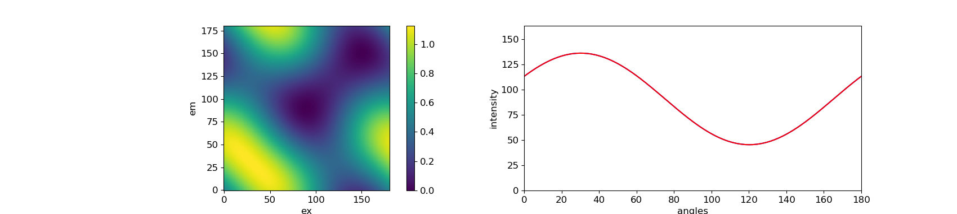
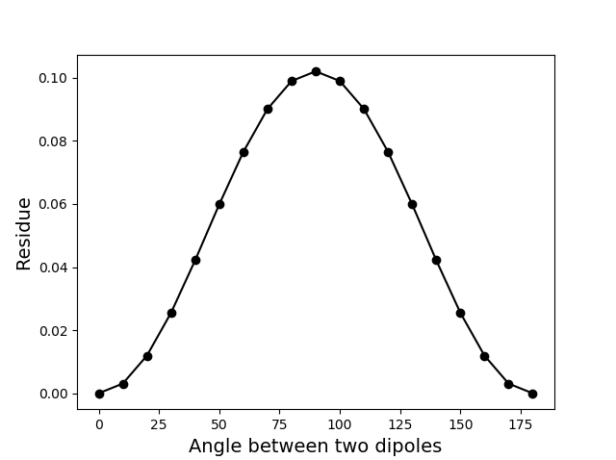
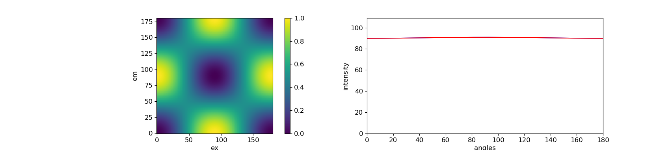
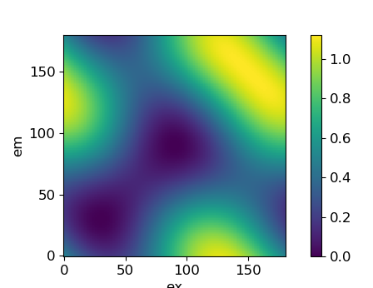
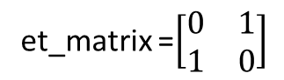
[0°, 30°]
et_matrix =$\left[\begin{matrix}0 & 1 \\ 1 & 0\end{matrix}\right]$
[0°, 60°]
[0°, 90°]
[0°, 120°]

Slide 15
et portrait plays a role to break the symmetry (only in very special case et portrait is flat). Thus when there is et, the more asymmetry the portrait is, the easier to be fit by the model. This explains the angle dependent residue.
On the other word, if the 2D portrait are still axis symmetric along both diagonal and x/y axis after energy transfer, then the model can not work.
model
et
noet
=
+
Asymmetry
Asymmetry
Only in few cases,
et can be flat
Symmetry

Slide 16
Section 2. large systems

Slide 17
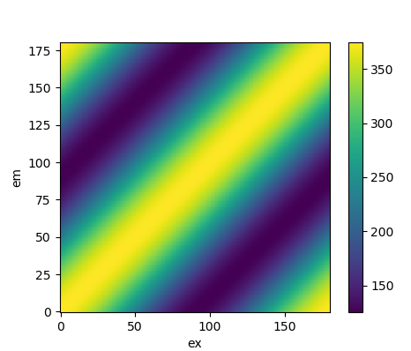
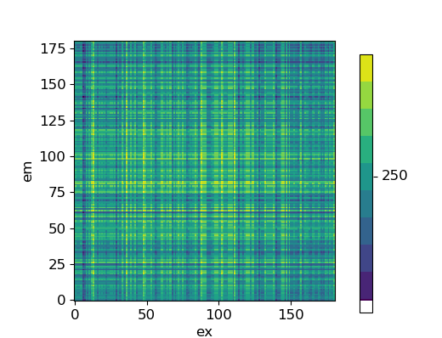
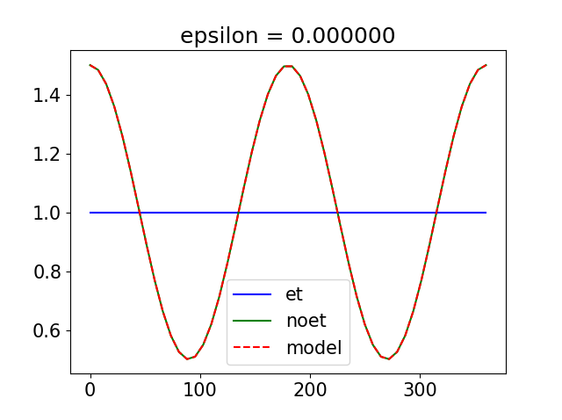
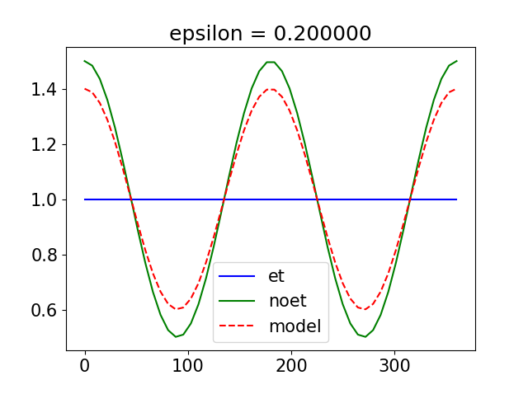
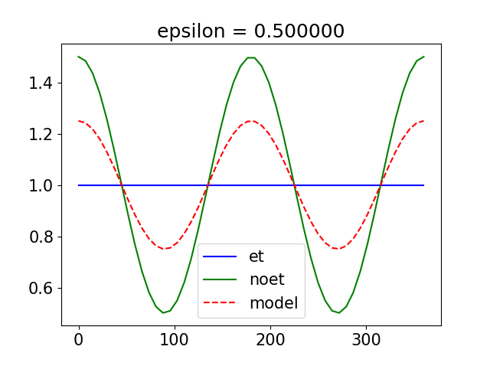
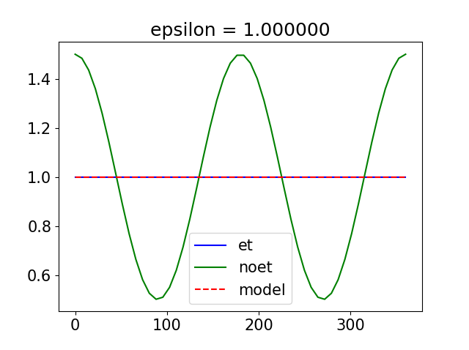
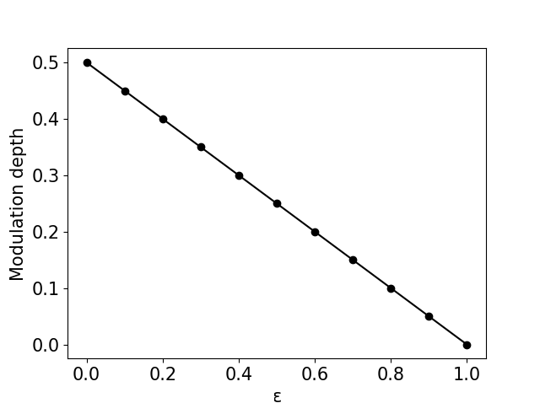
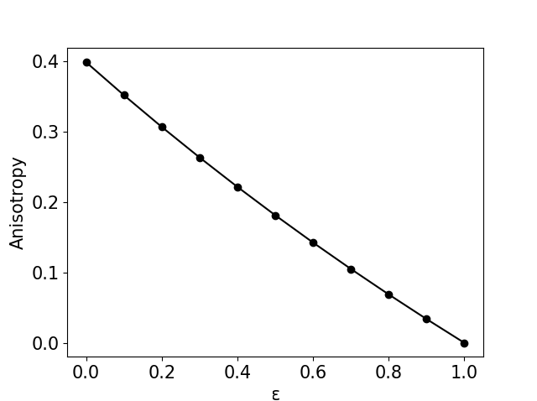
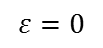
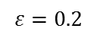
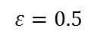
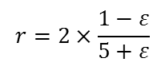
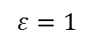
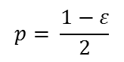
Solution (anisotropy – et)
No et
Full et
$$ε=0$$
$$ε=0.2$$
$$ε=0.5$$
$$ε=1$$
$$p= \frac{1−ε}{2}$$
$$r=2×\frac{1−ε}{5+ε}$$

Slide 18
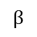
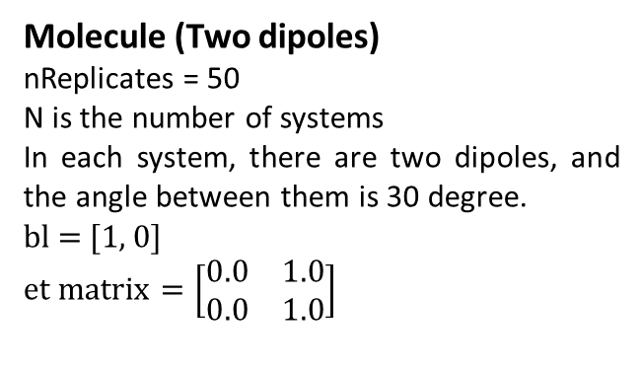
Molecule (Two dipoles)
nReplicates = 50
N is the number of systems
In each system, there are two dipoles, and the angle between them is 30 degree.
bl = [1, 0]
$$et matrix=\left[\begin{matrix}0.0 & 1.0 \\ 0.0 & 1.0\end{matrix}\right]$$
100%
$$β$$
A molecule have independent polarized absorber (M = 1) and emitter (M = 1). 100% energy transfer from absorber to emitter.
N = 1
N = 2
N = 4

Slide 19




Plot N – et for different angle between two dipoles
Fitting of 40 degree is not good
${et}_{30}=0.55×N^{−1.07}+0.48$
${et}_{20}=0.82×N^{−1.15}+0.21$
${et}_{10}=0.93×N^{−1.54}+0.07$

Slide 20


Slide 21










0°
$$r_{0}=2×\frac{1−ε}{5+ε}$$
40°
90°
Work for 3D
140°
$$r_{0}= \frac{2}{5} ×\left(\frac{3×\cos^{2}{β}−1}{2}\right)$$
$$r_{0}=2×\frac{1−ε}{5+ε}$$
170°

Slide 22




Molecule(Three dipoles, Mex is changed from 0 to 1)
100%
100%
$$β$$
Theta = [79, 109, 49]
The first one is the center dipole
bl = [False, True, True]
$β$ = 30°

Slide 23





100%
100%
$$β$$
100%
100%
$$β$$
100%
100%
$$β$$

Slide 24


Slide 25



Slide 26
Others

Slide 27




How many dipoles can be distinguished from 2D portrait
Plot the data along diagonal of 2D portrait
theta = [0, 60, 120]
et_matrix = ([1.0, 0.0, 0.0],
[0.0, 1.0, 0.0],
[0.0, 0.0, 1.0])
theta = [0, 60, 120]
et_matrix = ([0.5, 0.5, 0.0],
[0.0, 1.0, 0.0],
[0.0, 0.0, 1.0])

Slide 28






FFT of 2D portrait
0
0, 90
0, 60, 120
0, 45, 90, 135
0, 36, 72, 108, 144
0, 30, 60, 90, 120, 150
Can we do more image analysis on 2D portrait to obtain more useful info?

Slide 30
The SFA fitting results can give us some hint for an completely unknown system
M_funnel | phase_funnel | et
High | Different from the averaged excitation phase | The amount of energy are transferred | Energy flow to One or several specific emitters (funnel effect)
Low | Close to the averaged excitation phase | The amount of energy are transferred | There is some independent systems. And the energy transfer within each system.

Slide 31





[0°, 120°]
$$et matrix=\left[\begin{matrix}0.8 & 0.2 \\ 0.0 & 1.0\end{matrix}\right]$$
Phase_ex
One can judge if there is a single polarized emitter in the system from the phase and M of the funnel.
If the energy flow to only one dipole. No matter how much of the energy, SFA fitting always shows that M_funnel = 1, and phase of the funnel (the same as one of the emitter) is different from the average excitation phase.
The value of et shows how much energy transfer to this one emitter.

Slide 32




[0°, 30°, 60°, 90°]
[0.4, 0.6, 0.0, 0.0]
[0.0, 1.0, 0.0, 0.0]
[0.0, 0.6, 0.4, 0.0]
[0.0, 0.6, 0.0, 0.4]
M = 1
Phase of the funnel is different from the averaged excitation phase

Slide 33




0°, 30°, 60°, 90°
[1.0, 0.0, 0.0, 0.0]
[0.0, 1.0, 0.0, 0.0]
[0.2, 0.5, 0.3, 0.0]
[0.2, 0.5, 0.0, 0.3]
M = 1
Phase of the funnel is different from the averaged excitation phase

Slide 34
0°, 30°, 60°, 90°
[1.0, 0.0, 0.0, 0.0]
[0.0, 1.0, 0.0, 0.0]
[0.2, 0.5, 0.3, 0.0]
[0.2, 0.5, 0.0, 0.3]
M = 1
Phase of the funnel is different from the averaged excitation phase

Slide 35





[0°, 120°]
$$et matrix=\left[\begin{matrix}0.8 & 0.2 \\ 0.2 & 0.8\end{matrix}\right]$$
M is relatively low
phase is very close to the average excitation phase.
It means that there is energy transfer process in the system (et shows how much it is), but the energy does not go to one specific emitter.
100%
120°
100%
120°

Slide 36




[0°, 30°, 60°, 90°]
[0.8, 0.2, 0.0, 0.0],
[0.4, 0.6, 0.0, 0.0],
[0.0, 0.0, 0.5, 0.5],
[0.0, 0.0, 0.2, 0.8]
M is low
Phase of the funnel is close to the averaged excitation phase

